Slide 1
Extracting an Interface

Slide 2
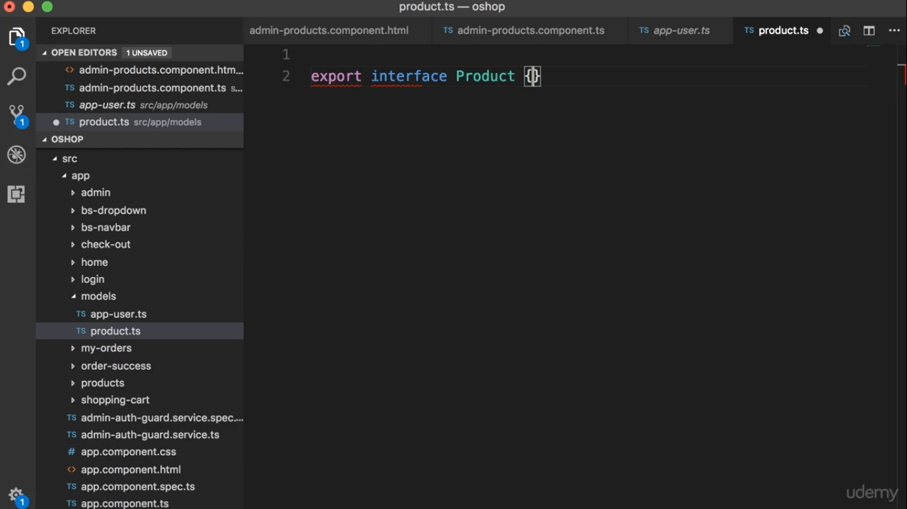

Slide 3
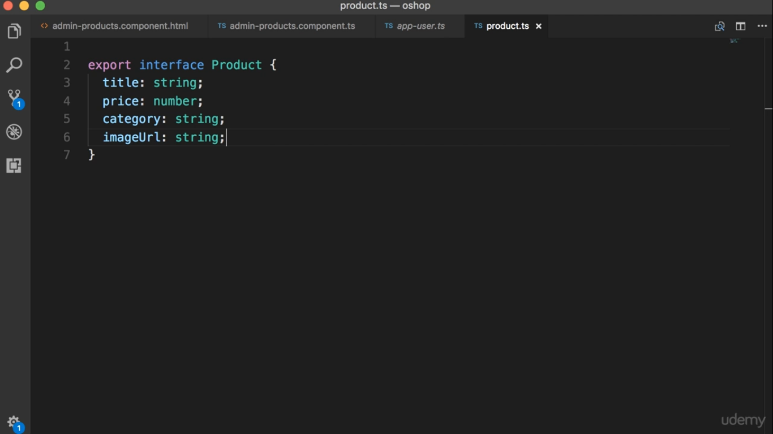

Slide 4
